Slide 1

Solving problems by Search
, 2022
Goal-based Agents
Atomic-Factored-Structured
Dr. Bilal Hoteit
Notes:
Today i will present you AN ADAPTIVE MULTIMODAL INTERFACE TO IMPROVE ELDERLY PEOPLE'S REHABILIATION EXERCISES

Slide 2

Introduction to Artificial Intelligence
  Constraint satisfaction problem
  Requirements: Linear Programming
Notes:
The main chapters that I will detail are

Slide 3
Introduction to Artificial Intelligence
  Requirements: Linear Programming
  Lecture 3 , p:67 - 73
  Src3 – production.py
Notes:
The main chapters that I will detail are

Slide 4

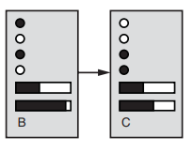
Prerequisites
Purpose
AI définitions
AI Types
Trendings
Confused
Context
1
, 2022
Difference between Representations
  Atomic representation means a state representing single variable.
  Black box, no internal structure.
  Factored representation means a State consists of a vector of attribute values.
  Each state has several variables and may be each variable can have a set of values.
Notes:
Nowadays the multimodal interfaces offer a more natural way of interaction with the recent technology.
We apply our work in the health care domain for elderly people recovering from physical affections that require physical rehabilitation exercises through serious games.
We propose a system that aims to assist the patients while performing these physical exercises, to increase ... Using Elearning

Slide 5
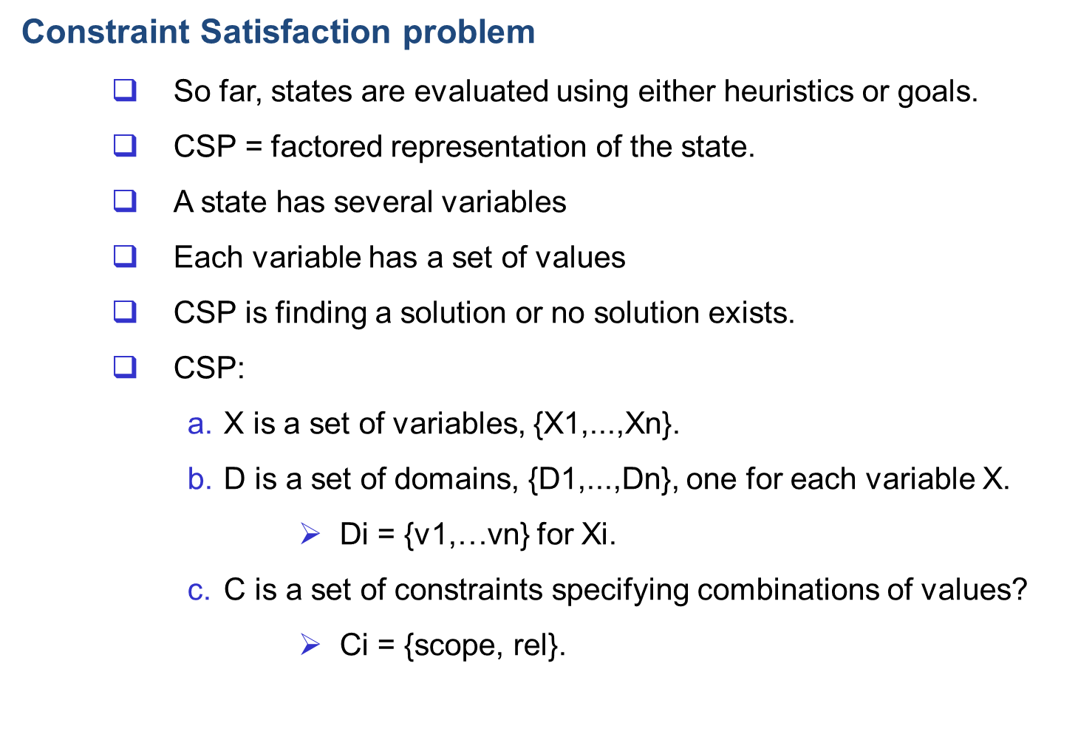
Prerequisites
Purpose
AI définitions
AI Types
Trendings
Confused
Context
1
, 2022

Slide 6
Prerequisites
Purpose
AI définitions
AI Types
Trendings
Confused
Context
1
, 2022
Constraint Satisfaction problem
      Simulation go to word file in chapter seven folder.
Simulation for back tracking algorithm:
Constraint Satisfaction: introduction - …

Slide 7

Prerequisites
Purpose
AI définitions
AI Types
Trendings
Confused
Context
1
, 2022
Constraint Satisfaction problem formulation
Example: Map Austria color
  Variables WA, NT, Q, NSW, V, SA, T .
  Domains D_{i} = {red,green,blue} .
  Constraints: adjacent regions must have different colors .
e.g., WA ≠ NT, or (WA,NT) in { (red,green), (red,blue), (green,red), (green,blue), (blue,red), (blue,green) }
Notes:
Nowadays the multimodal interfaces offer a more natural way of interaction with the recent technology.
We apply our work in the health care domain for elderly people recovering from physical affections that require physical rehabilitation exercises through serious games.
We propose a system that aims to assist the patients while performing these physical exercises, to increase ... Using Elearning

Slide 8

Prerequisites
Purpose
AI définitions
AI Types
Trendings
Confused
Context
1
, 2022
Constraint Satisfaction problem formulation
Example: Map Austria color
  Variables WA, NT, Q, NSW, V, SA, T .
  Domains D_{i} = {red,green,blue} .
  Constraints: adjacent regions must have different colors .
Solutions are complete and consistent assignments, e.g., WA = red, NT = green, Q = red, NSW = green, V = red, SA = blue, T = green.
Notes:
Nowadays the multimodal interfaces offer a more natural way of interaction with the recent technology.
We apply our work in the health care domain for elderly people recovering from physical affections that require physical rehabilitation exercises through serious games.
We propose a system that aims to assist the patients while performing these physical exercises, to increase ... Using Elearning

Slide 9

Prerequisites
Purpose
AI définitions
AI Types
Trendings
Confused
Context
1
, 2022
Constraint Satisfaction problem formulation
Example: Map Austria color
Constraint graph: nodes are variables, arcs are constraints.
Unary constraints involve a single variable,
  e.g., SA ≠ green
Binary constraints involve pairs of variables, e.g., SA ≠ WA
Higher-order constraints involve 3 or more variables.
Notes:
Nowadays the multimodal interfaces offer a more natural way of interaction with the recent technology.
We apply our work in the health care domain for elderly people recovering from physical affections that require physical rehabilitation exercises through serious games.
We propose a system that aims to assist the patients while performing these physical exercises, to increase ... Using Elearning

Slide 10
Prerequisites
Purpose
AI définitions
AI Types
Trendings
Confused
Context
1
, 2022
Constraint Satisfaction problem formulation
Another Example.
Scheduling example…
  Lecture 3 , p:74 - 157
Note: Node and ARC consistency
Note: Then back tracking algorithm
Code: back tracking algorithm demonstration
Src3 – scheduling0.py
python-constraint
Src3 – scheduling1.py
Notes:
Nowadays the multimodal interfaces offer a more natural way of interaction with the recent technology.
We apply our work in the health care domain for elderly people recovering from physical affections that require physical rehabilitation exercises through serious games.
We propose a system that aims to assist the patients while performing these physical exercises, to increase ... Using Elearning

Slide 11
Prerequisites
Purpose
AI définitions
AI Types
Trendings
Confused
Context
1
, 2022
Constraint Satisfaction problem formulation
Inference (optimization)….
Scheduling example…
  Lecture 3 , p:158 - 184
Note: Arc consistency
  Which variable should be assigned next?
  In what order should its values be tried?
  Can we detect inevitable failure early?
Then: Another problem simulation….
Notes:
Nowadays the multimodal interfaces offer a more natural way of interaction with the recent technology.
We apply our work in the health care domain for elderly people recovering from physical affections that require physical rehabilitation exercises through serious games.
We propose a system that aims to assist the patients while performing these physical exercises, to increase ... Using Elearning

Slide 12

Prerequisites
Purpose
AI définitions
AI Types
Trendings
Confused
Context
1
, 2022
Constraint Satisfaction problem
Back track algorithm
Notes:
Nowadays the multimodal interfaces offer a more natural way of interaction with the recent technology.
We apply our work in the health care domain for elderly people recovering from physical affections that require physical rehabilitation exercises through serious games.
We propose a system that aims to assist the patients while performing these physical exercises, to increase ... Using Elearning

Slide 13

Prerequisites
Purpose
AI définitions
AI Types
Trendings
Confused
Context
1
, 2022
Constraint Satisfaction problem
Back track algorithm simulation.
Notes:
Nowadays the multimodal interfaces offer a more natural way of interaction with the recent technology.
We apply our work in the health care domain for elderly people recovering from physical affections that require physical rehabilitation exercises through serious games.
We propose a system that aims to assist the patients while performing these physical exercises, to increase ... Using Elearning

Slide 14

Prerequisites
Purpose
AI définitions
AI Types
Trendings
Confused
Context
1
, 2022
Constraint Satisfaction problem
Back track algorithm simulation.
Notes:
Nowadays the multimodal interfaces offer a more natural way of interaction with the recent technology.
We apply our work in the health care domain for elderly people recovering from physical affections that require physical rehabilitation exercises through serious games.
We propose a system that aims to assist the patients while performing these physical exercises, to increase ... Using Elearning

Slide 15

Prerequisites
Purpose
AI définitions
AI Types
Trendings
Confused
Context
1
, 2022
Constraint Satisfaction problem
Back track algorithm simulation.
Notes:
Nowadays the multimodal interfaces offer a more natural way of interaction with the recent technology.
We apply our work in the health care domain for elderly people recovering from physical affections that require physical rehabilitation exercises through serious games.
We propose a system that aims to assist the patients while performing these physical exercises, to increase ... Using Elearning

Slide 16
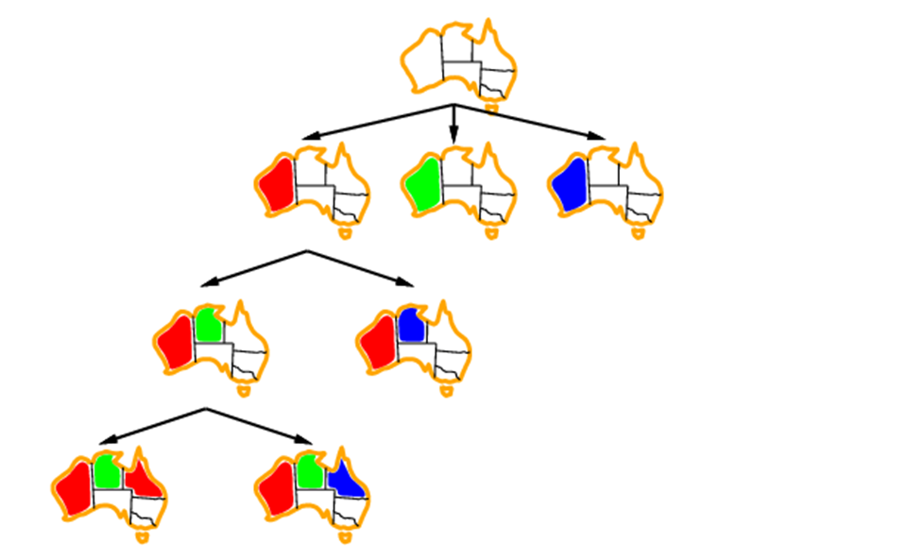
Prerequisites
Purpose
AI définitions
AI Types
Trendings
Confused
Context
1
, 2022
Constraint Satisfaction problem
Back track algorithm simulation.
Notes:
Nowadays the multimodal interfaces offer a more natural way of interaction with the recent technology.
We apply our work in the health care domain for elderly people recovering from physical affections that require physical rehabilitation exercises through serious games.
We propose a system that aims to assist the patients while performing these physical exercises, to increase ... Using Elearning

Slide 17
Prerequisites
Purpose
AI définitions
AI Types
Trendings
Confused
Context
1
, 2022
Back track algorithm
Improving backtracking efficiency
General-purpose methods can give huge gains in speed:
  Which variable should be assigned next?
  In what order should its values be tried?
  Can we detect inevitable failure early?
Notes:
Nowadays the multimodal interfaces offer a more natural way of interaction with the recent technology.
We apply our work in the health care domain for elderly people recovering from physical affections that require physical rehabilitation exercises through serious games.
We propose a system that aims to assist the patients while performing these physical exercises, to increase ... Using Elearning

Slide 18
Prerequisites
Purpose
AI définitions
AI Types
Trendings
Confused
Context
1
, 2022
Back track algorithm
Improving backtracking efficiency
General-purpose methods can give huge gains in speed:
  Which variable should be assigned next?
  In what order should its values be tried?
  Can we detect inevitable failure early?
Notes:
Nowadays the multimodal interfaces offer a more natural way of interaction with the recent technology.
We apply our work in the health care domain for elderly people recovering from physical affections that require physical rehabilitation exercises through serious games.
We propose a system that aims to assist the patients while performing these physical exercises, to increase ... Using Elearning

Slide 19

Prerequisites
Purpose
AI définitions
AI Types
Trendings
Confused
Context
1
, 2022
Back track algorithm
Improving backtracking efficiency
Most constrained variable:
  choose the variable with the fewest legal values
a.k.a. minimum remaining values (MRV) heuristic
Notes:
Nowadays the multimodal interfaces offer a more natural way of interaction with the recent technology.
We apply our work in the health care domain for elderly people recovering from physical affections that require physical rehabilitation exercises through serious games.
We propose a system that aims to assist the patients while performing these physical exercises, to increase ... Using Elearning

Slide 20

Prerequisites
Purpose
AI définitions
AI Types
Trendings
Confused
Context
1
, 2022
Back track algorithm
Improving backtracking efficiency
Most constrained variable:
  choose the variable with the fewest legal values
choose the variable with the most constraints on remaining variables
Notes:
Nowadays the multimodal interfaces offer a more natural way of interaction with the recent technology.
We apply our work in the health care domain for elderly people recovering from physical affections that require physical rehabilitation exercises through serious games.
We propose a system that aims to assist the patients while performing these physical exercises, to increase ... Using Elearning

Slide 21

Prerequisites
Purpose
AI définitions
AI Types
Trendings
Confused
Context
1
, 2022
Back track algorithm
Improving backtracking efficiency
Least constraining value:
The one that rules out the fewest values in the remaining values
Combining these heuristics makes 1000 queens feasible.
Notes:
Nowadays the multimodal interfaces offer a more natural way of interaction with the recent technology.
We apply our work in the health care domain for elderly people recovering from physical affections that require physical rehabilitation exercises through serious games.
We propose a system that aims to assist the patients while performing these physical exercises, to increase ... Using Elearning

Slide 22
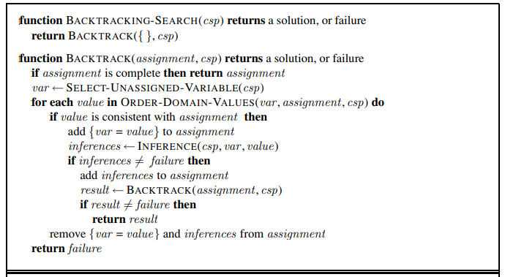
Prerequisites
Purpose
AI définitions
AI Types
Trendings
Confused
Context
1
, 2022
Back track algorithm
Improving backtracking efficiency
Notes:
Nowadays the multimodal interfaces offer a more natural way of interaction with the recent technology.
We apply our work in the health care domain for elderly people recovering from physical affections that require physical rehabilitation exercises through serious games.
We propose a system that aims to assist the patients while performing these physical exercises, to increase ... Using Elearning

Slide 23

Prerequisites
Purpose
AI définitions
AI Types
Trendings
Confused
Context
1
, 2022
Back track algorithm
Improving backtracking efficiency
Idea: Inference mechanisms (propagation using forward checking, or CS3)
Keep track of remaining legal values for unassigned variables
Terminate search when any variable has no legal values
Notes:
Nowadays the multimodal interfaces offer a more natural way of interaction with the recent technology.
We apply our work in the health care domain for elderly people recovering from physical affections that require physical rehabilitation exercises through serious games.
We propose a system that aims to assist the patients while performing these physical exercises, to increase ... Using Elearning

Slide 24

Prerequisites
Purpose
AI définitions
AI Types
Trendings
Confused
Context
1
, 2022
Back track algorithm
Improving backtracking efficiency
Idea: Inference mechanisms (propagation using forward checking, or CS3)
Keep track of remaining legal values for unassigned variables
Terminate search when any variable has no legal values
Notes:
Nowadays the multimodal interfaces offer a more natural way of interaction with the recent technology.
We apply our work in the health care domain for elderly people recovering from physical affections that require physical rehabilitation exercises through serious games.
We propose a system that aims to assist the patients while performing these physical exercises, to increase ... Using Elearning

Slide 25

Prerequisites
Purpose
AI définitions
AI Types
Trendings
Confused
Context
1
, 2022
Back track algorithm
Improving backtracking efficiency
Idea: Inference mechanisms (propagation using forward checking, or CS3)
Keep track of remaining legal values for unassigned variables
Terminate search when any variable has no legal values
Notes:
Nowadays the multimodal interfaces offer a more natural way of interaction with the recent technology.
We apply our work in the health care domain for elderly people recovering from physical affections that require physical rehabilitation exercises through serious games.
We propose a system that aims to assist the patients while performing these physical exercises, to increase ... Using Elearning

Slide 26

Prerequisites
Purpose
AI définitions
AI Types
Trendings
Confused
Context
1
, 2022
Back track algorithm
Improving backtracking efficiency
Idea: Inference mechanisms (propagation using forward checking, or CS3)
Keep track of remaining legal values for unassigned variables
Terminate search when any variable has no legal values
Notes:
Nowadays the multimodal interfaces offer a more natural way of interaction with the recent technology.
We apply our work in the health care domain for elderly people recovering from physical affections that require physical rehabilitation exercises through serious games.
We propose a system that aims to assist the patients while performing these physical exercises, to increase ... Using Elearning

Slide 27
Prerequisites
Purpose
AI définitions
AI Types
Trendings
Confused
Context
1
, 2022
Back track algorithm
Improving backtracking efficiency
Forward checking propagates information from assigned to unassigned variables, but doesn't provide early detection for all failures:
NT and SA cannot both be blue!
Constraint propagation repeatedly enforces constraints locally.
Notes:
Nowadays the multimodal interfaces offer a more natural way of interaction with the recent technology.
We apply our work in the health care domain for elderly people recovering from physical affections that require physical rehabilitation exercises through serious games.
We propose a system that aims to assist the patients while performing these physical exercises, to increase ... Using Elearning

Slide 28

Prerequisites
Purpose
AI définitions
AI Types
Trendings
Confused
Context
1
, 2022
Back track algorithm
Improving backtracking efficiency
Arc consistency:
Simplest form of propagation makes each arc consistent
X →Y is consistent iff:
  for every value x of X there is some allowed y
Notes:
Nowadays the multimodal interfaces offer a more natural way of interaction with the recent technology.
We apply our work in the health care domain for elderly people recovering from physical affections that require physical rehabilitation exercises through serious games.
We propose a system that aims to assist the patients while performing these physical exercises, to increase ... Using Elearning

Slide 29

Prerequisites
Purpose
AI définitions
AI Types
Trendings
Confused
Context
1
, 2022
Back track algorithm
Improving backtracking efficiency
Arc consistency:
Simplest form of propagation makes each arc consistent
X →Y is consistent iff:
  for every value x of X there is some allowed y
Notes:
Nowadays the multimodal interfaces offer a more natural way of interaction with the recent technology.
We apply our work in the health care domain for elderly people recovering from physical affections that require physical rehabilitation exercises through serious games.
We propose a system that aims to assist the patients while performing these physical exercises, to increase ... Using Elearning

Slide 30

Prerequisites
Purpose
AI définitions
AI Types
Trendings
Confused
Context
1
, 2022
Back track algorithm
Improving backtracking efficiency
Arc consistency:
Simplest form of propagation makes each arc consistent
X →Y is consistent iff:
  for every value x of X there is some allowed y
If X loses a value, neighbors of X need to be rechecked
Notes:
Nowadays the multimodal interfaces offer a more natural way of interaction with the recent technology.
We apply our work in the health care domain for elderly people recovering from physical affections that require physical rehabilitation exercises through serious games.
We propose a system that aims to assist the patients while performing these physical exercises, to increase ... Using Elearning

Slide 31

Prerequisites
Purpose
AI définitions
AI Types
Trendings
Confused
Context
1
, 2022
Back track algorithm
Improving backtracking efficiency
Arc consistency:
Simplest form of propagation makes each arc consistent
X →Y is consistent iff:
  for every value x of X there is some allowed y
If X loses a value, neighbors of X need to be rechecked.
Arc consistency detects failure earlier than forward checking.
Can be run as a preprocessor or after each assignment.
Notes:
Nowadays the multimodal interfaces offer a more natural way of interaction with the recent technology.
We apply our work in the health care domain for elderly people recovering from physical affections that require physical rehabilitation exercises through serious games.
We propose a system that aims to assist the patients while performing these physical exercises, to increase ... Using Elearning

Slide 32

Prerequisites
Purpose
AI définitions
AI Types
Trendings
Confused
Context
1
, 2022
Arc consistency algorithm AC-3
Notes:
Nowadays the multimodal interfaces offer a more natural way of interaction with the recent technology.
We apply our work in the health care domain for elderly people recovering from physical affections that require physical rehabilitation exercises through serious games.
We propose a system that aims to assist the patients while performing these physical exercises, to increase ... Using Elearning

Slide 33
Prerequisites
Purpose
AI définitions
AI Types
Trendings
Confused
Context
1
, 2022
Local search for CSPs
Hill-climbing, simulated annealing typically work with "complete" states, i.e., all variables assigned
To apply to CSPs:
  allow states with unsatisfied constraints.
  operators reassign variable values.
Variable selection: randomly select any conflicted variable
Value selection by min-conflicts heuristic:
  Choose value that violates the fewest constraints
Notes:
Nowadays the multimodal interfaces offer a more natural way of interaction with the recent technology.
We apply our work in the health care domain for elderly people recovering from physical affections that require physical rehabilitation exercises through serious games.
We propose a system that aims to assist the patients while performing these physical exercises, to increase ... Using Elearning

Slide 34

Prerequisites
Purpose
AI définitions
AI Types
Trendings
Confused
Conclusion
12
, 2022
Thank you for your attention!
Questions?
Notes:
Nowadays the multimodal interfaces offer a more natural way of interaction with the recent technology.
We apply our work in the health care domain for elderly people recovering from physical affections that require physical rehabilitation exercises through serious games.
We propose a system that aims to assist the patients while performing these physical exercises, to increase ... Using Elearning

